Slide 1

Governance Board Meeting
January 30, 2023

Slide 2
Welcome
Steve Nash

Slide 3
Mission Moment
Linda Barnum

Slide 4
Chairman’s Report
Steve Nash

Slide 5
Minutes and Agenda
  Welcome to Janaury Board Meeting
    Mission Moment
    Chairman’s Report
    Operational Update
    Finance/Committee Update
    Program/Committee Update
    Advancement/Committee Update
    Strategic Discussion: New Facility
    Open Business
    Adjourn
Approval of November Minutes

Slide 6


2022 yearend celebration
Audit preparation
MACC Resolution
Building HOPE Committee
  SME with project management, construction planning, community advocacy

Slide 7
ED Update
LaChelle Williams

Slide 8

General Operational Updates
Board 1:1s scheduled in Q1
Team vision and structure
Human Resources
2023 Operational Plan
2023 Department Plans

Slide 9
Finance Review
Brooke Limanen | LaChelle
Don Phillips

Slide 10
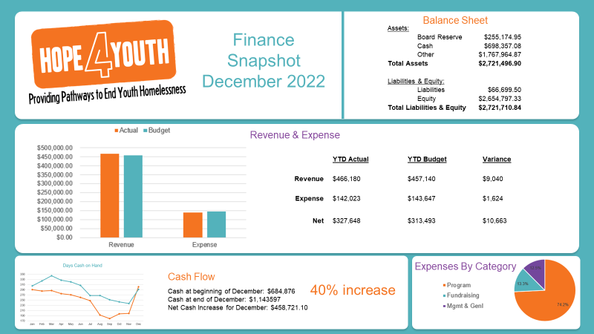
December Financials

Slide 11
Program Update
Anna VonRueden/Mark McNamer

Slide 12
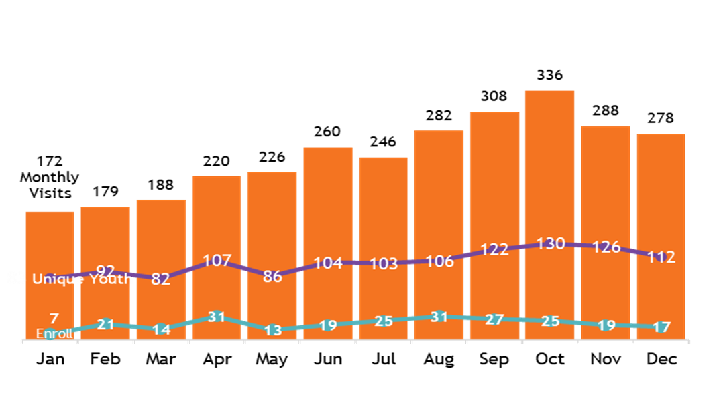
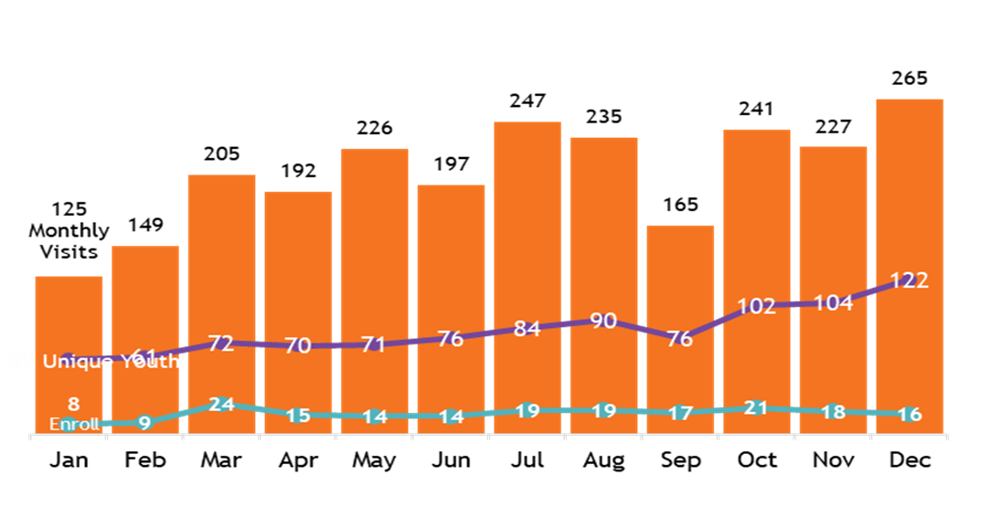
Year in Review Program Data
2022 Data (full report in March)
Drop-In Center
HOPE Place 2022
27 youth served
17 exited (11 successful)
Career Force Partnership 139 1:1 Sessions
*Youth Surveys will help guide program gaps and needed services
2021 vs 2022

Slide 13
Operational Highlight:
Advancement Update
JJ Slag/Nikki Kalvin

Slide 14

Advancement Vision
Year End Wrap Up: What we learned
How it informed our plan for 2023
Strategies
- First Time Donor retention
- Corporate and Civic Relationships
- Community Presence and Outreach
- Sustained Giving

Slide 15
Strategic Discussion:
New Facility

Slide 16

New Facility Vision and Progress
HF148/HF149 and SF214/SF215
Community messaging
Location exploration
Primary goal in coming weeks is to assemble Building HOPE committee & info
  SMEs
  Exploration of location options
  Construction pricing
CALL TO ACTION: Committee assembly

Slide 17
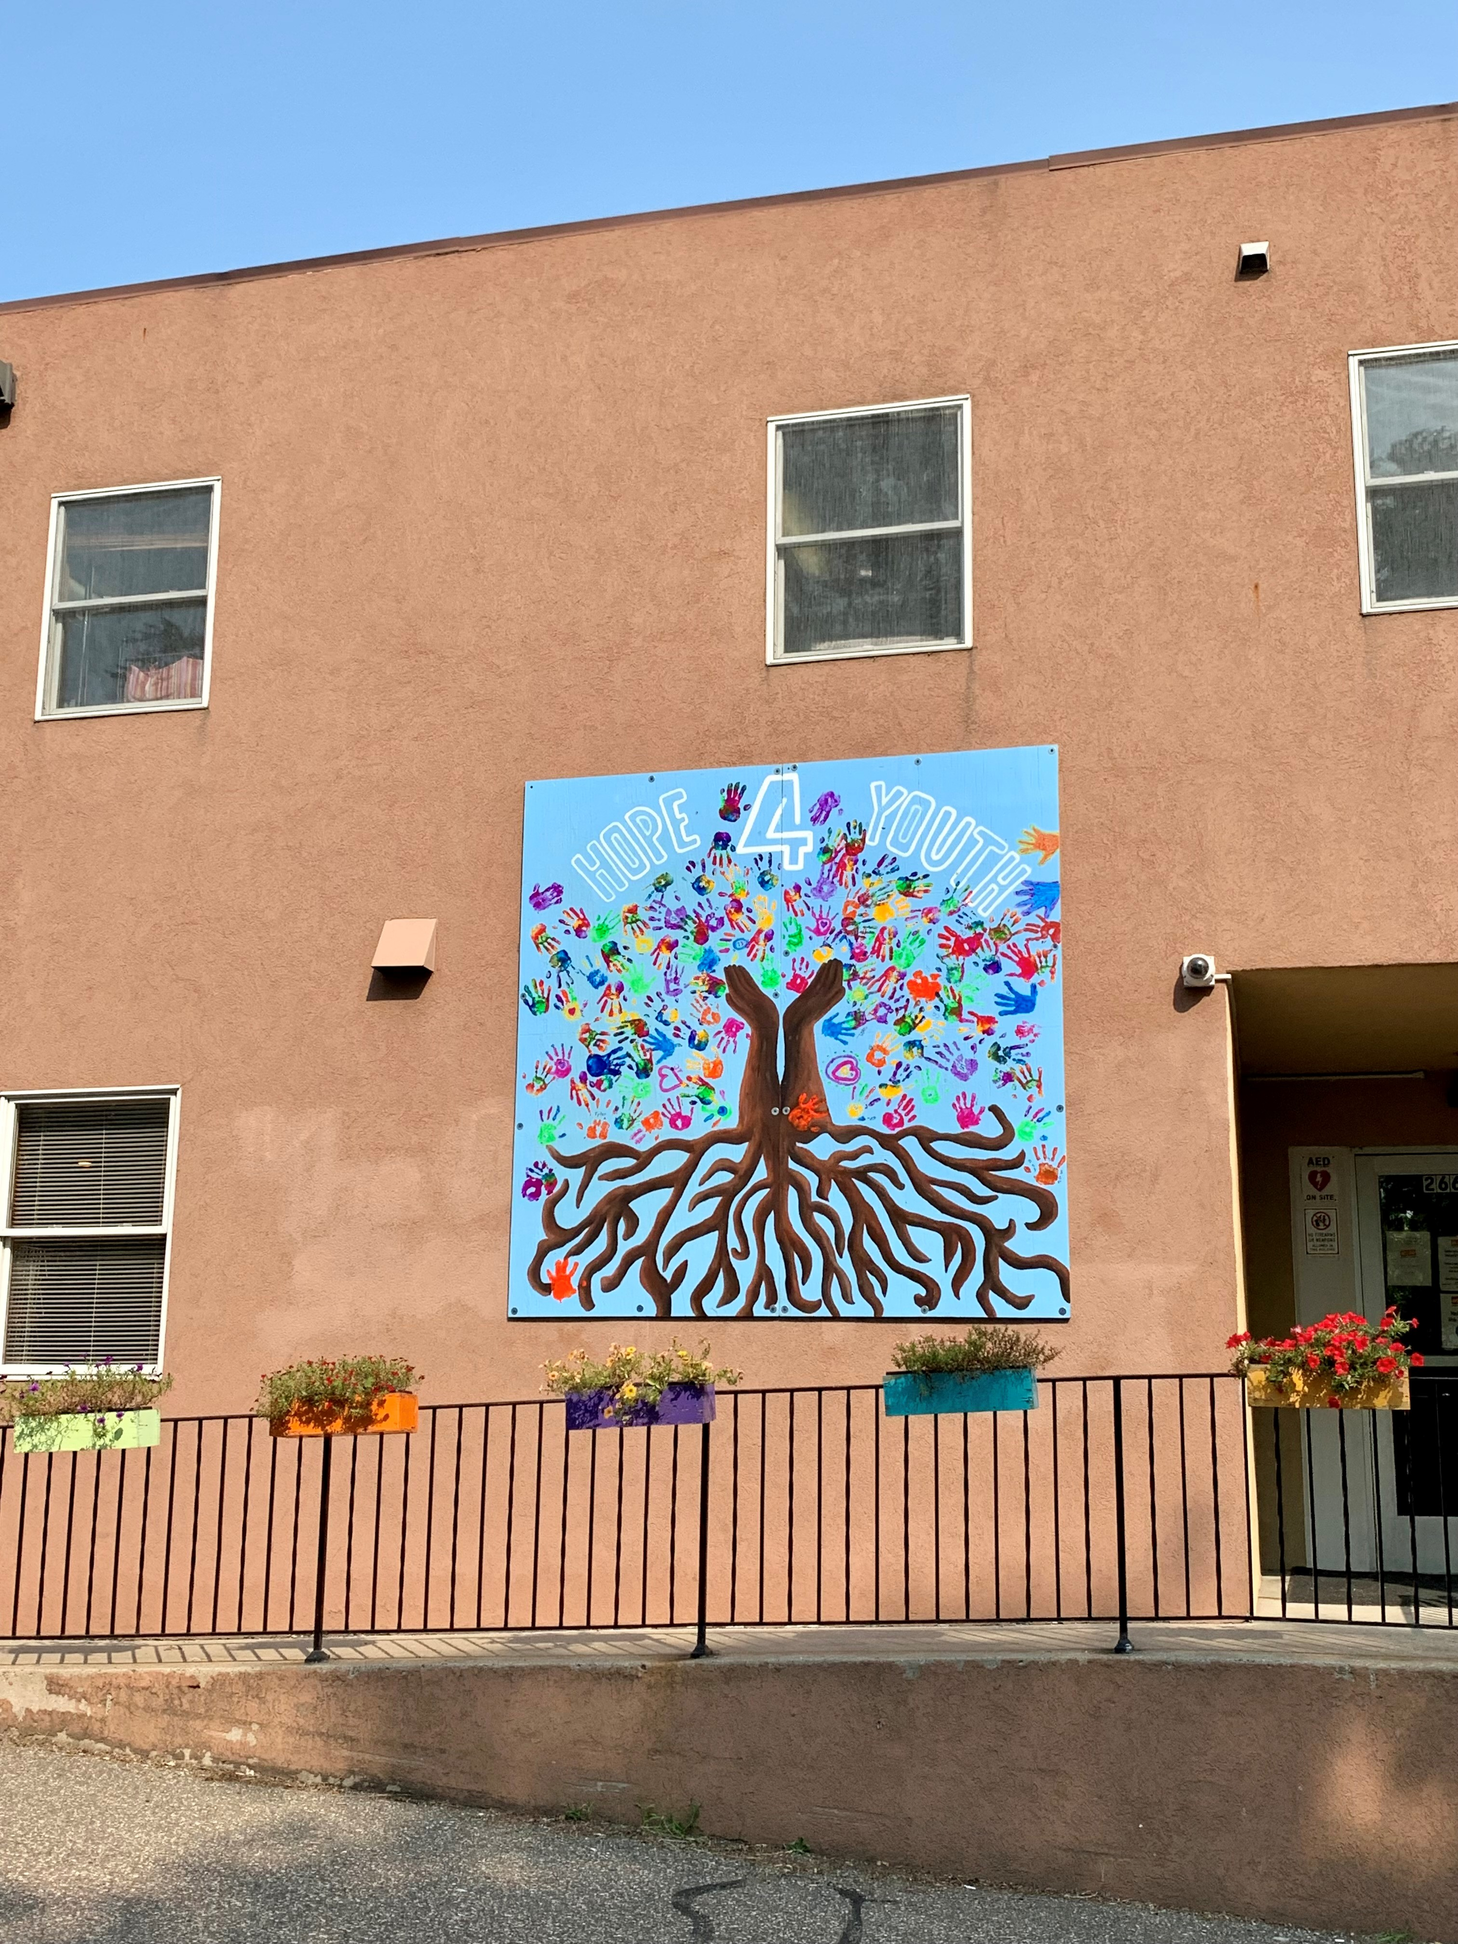
Ask $8 Million
Legislative Bill
Property
Construction/Site Prep/ Utilities/Pavement/etc
Design (10% of construction)
Activation of fixtures, furnishings, and equipment
Moving expenses

Slide 18
Location
Exploration phase
HOPE Place site expansion
Anoka County Site
  Coon Rapids
  Blaine
  Other?
Accessible to youth
On public transportation
Within price range
Appropriate zoning
Parking

Slide 19
Working Together
Board | Committee Responsibilities
New Facility Vision
Location strategy
Funding strategy
Financial oversight
RFP process; Architect | Construction
Staff Responsibilities
Legislative arena
Community launch
Building design
Operational direction
Program vision and partnership development

Slide 20
Building Committee
Subject Matter Experts (SME)
Capital Finance
NP Property Development
Project Management
Facilities Management (ad hoc)
Seeking 3-4 Committee Members with Board overlap
Board | Committee Responsibilities
New Facility Vision
Location Strategy
Funding Strategy
Financial oversight
RFP process

Slide 21
Open Business
All

Slide 22
Thank You!

