Slide 1


Governance Board Meeting
July 22, 2024

Slide 2
Welcome & Tour
Anna VonRueden

Slide 3
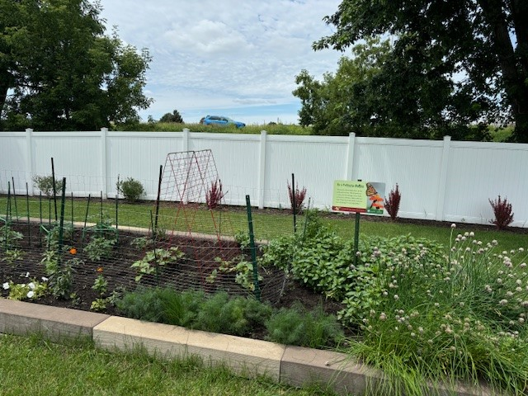
Tour Debrief
Anna VonRueden| Board

Slide 4

Mission Moment
James Lyght

Slide 5
Chairman’s Report
Anna VonRueden

Slide 6
Minutes and Agenda
Approval
of
May
Minutes
  Welcome - July Board Meeting
  Tour & Debrief
  Mission Moment
  Chairman’s Report
  Tour
  Operational Updates:
    Operational/Building HOPE Update
    Finance Review
    Advancement Update
    Open Business
  Adjourn

Slide 7
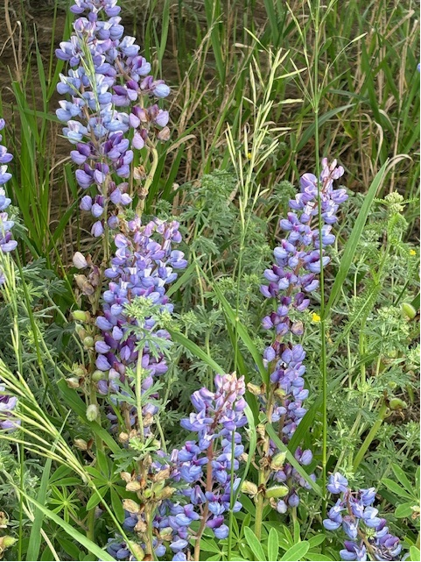
Executive Committee Update
Attire for Board Members (See ED Update for link)
Meeting Cadence
Toured potential facility

Slide 8
Operations & Building Update
LaChelle Williams | Steve Nash

Slide 9
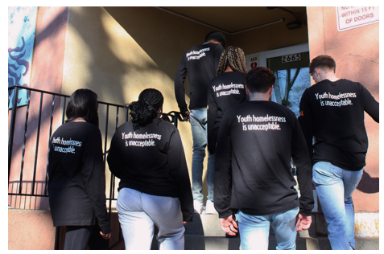
Operational Update
Board Communication - Portal
Operational Snapshot
New Facility progress

Slide 10
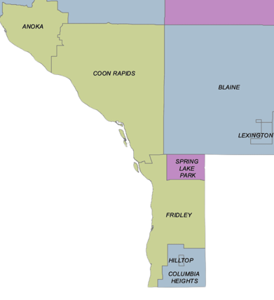

New Facility
Toured 8090 Rancher Road, Fridley – Issue with zoning; walked away
Continuing to explore locations
Engaged Anoka Commissioner, owner’s rep, building committee, Fridley city staff & Connexus Energy advocate in outreach
Steps when location is determined:
  Listening sessions
  City blessing and Planning Commission recommendation
  City Council approval

Slide 11
Financial Report
Brooke Limanen | Don Phillips

Slide 12

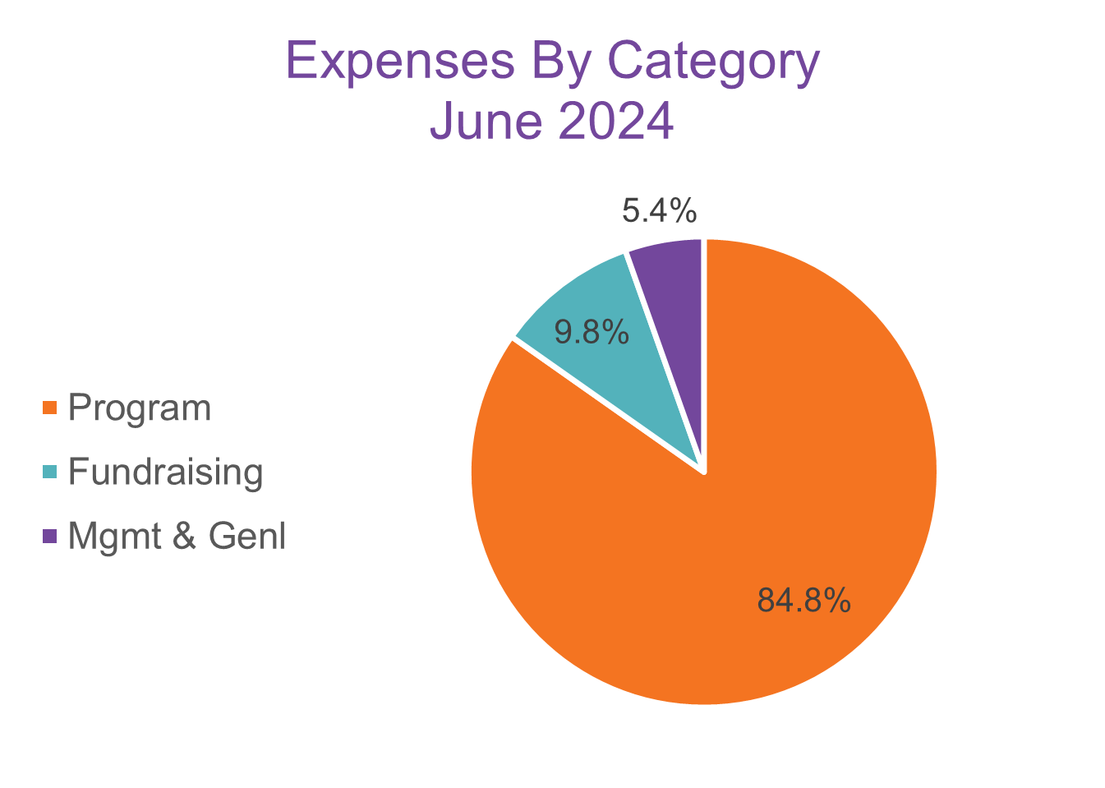
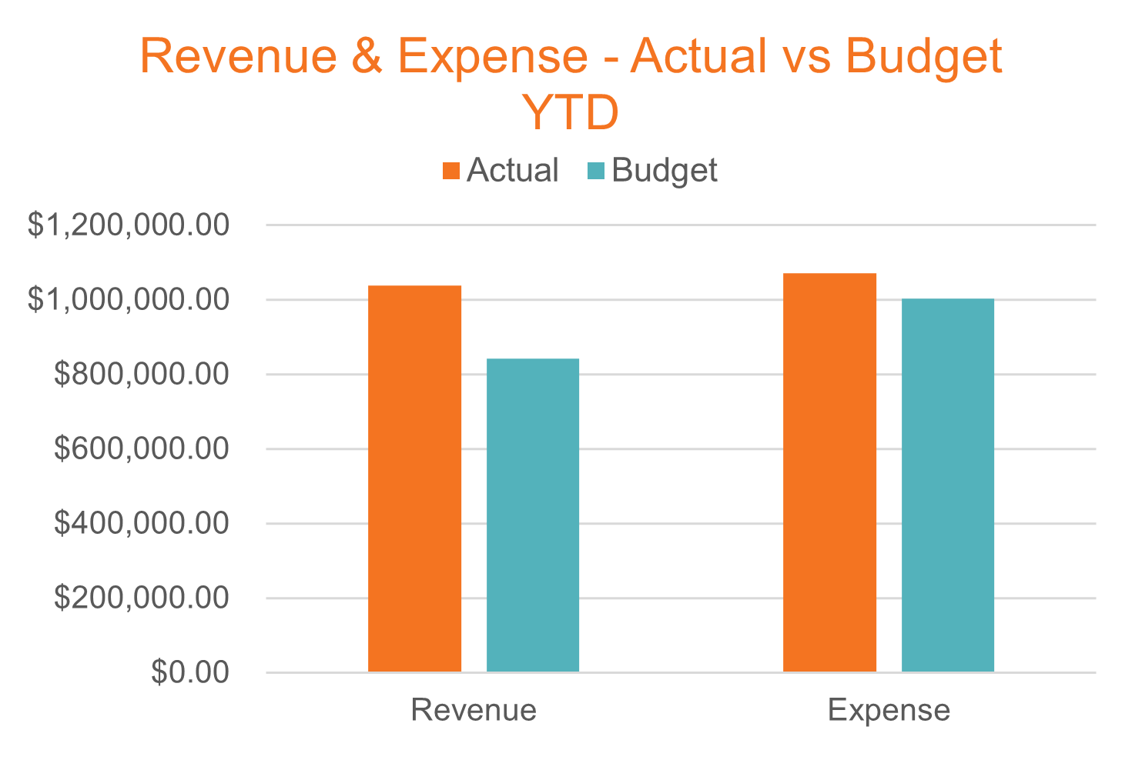
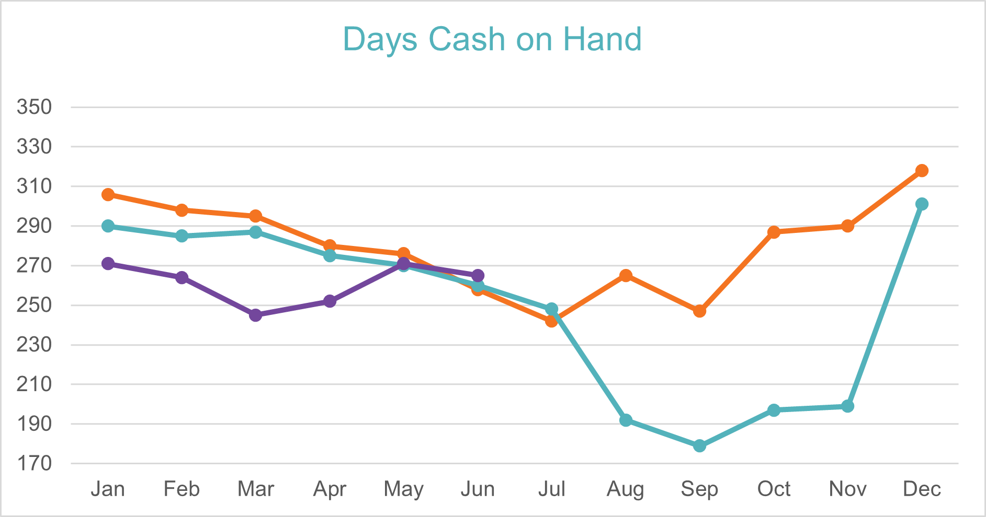
Finance Snapshot
June 2024
Program | 84.8% | $158,714
*Fundraising | 9.8% | $18,370
*Mgmt & Genl | 5.4% | $10,169

Slide 13
Advancement Snapshot
Nikki Kalvin |JJ Slag

Slide 14
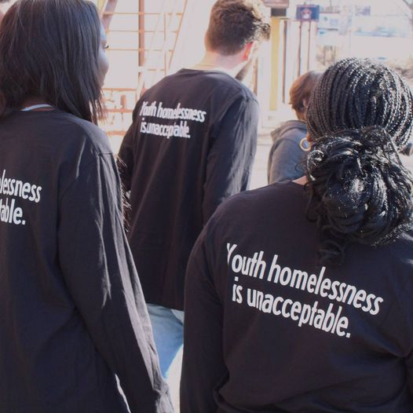
Advancement Progress
June 2024 compared to 2023
42% increase in volunteer hours
142% increase in food donations
45% increase in donations drives
100% increase in speaking engagements
89% increase in donations

Slide 15

Advancement Progress
Summer Kick-Off Challenge
KARE 11
Community Events
Darkest Night 4K call to Action

Slide 16
Open Business
All

Slide 17


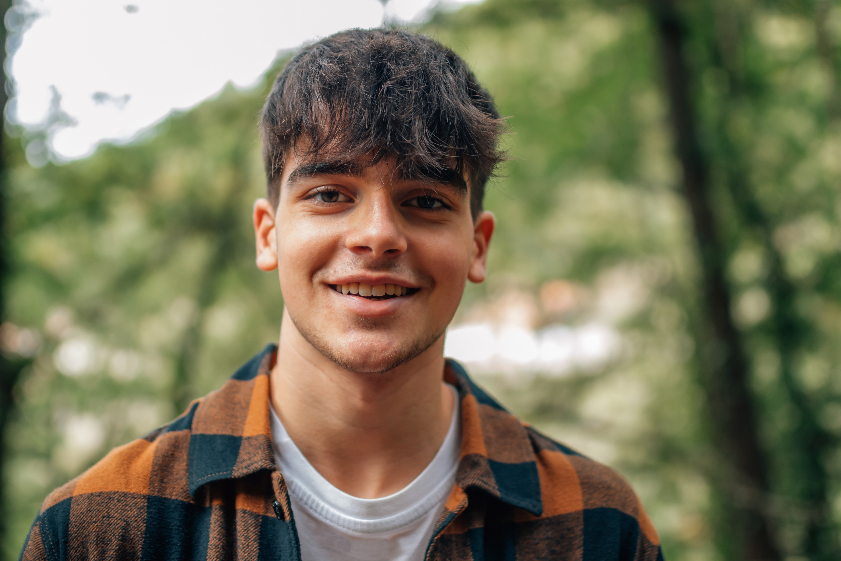
Thank You!

